Slide 1

Cyclistic Bike-Share Analysis: Maximizing Annual Memberships
A Data-Driven Marketing Strategy
Olha Tarasovets, Junior Data Analyst
Date: 24.05.2025

Slide 2
Business Objective
Understand usage differences between casual riders and members to create targeted marketing strategies for increasing annual membership

Slide 3
Analysis Overview
Explored ride data to compare usage patterns between casual and member users
Key focus areas:
Total ride duration
Average ride duration
Month ride patterns
Daily ride patterns
Time of peak usage
Tools used: R, Tableau

Slide 4
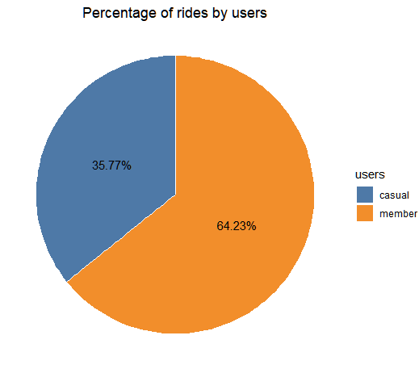
Ride Distribution by User Type
Members contribute the majority of rides
Casual riders still represent a significant segment, which can be converted into memberships

Slide 5
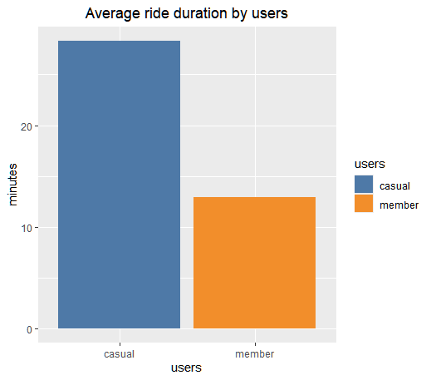
Average Ride Duration by User Type
Casual riders have significantly longer average ride durations compared to members
Casual riders may use bikes for leisure or one-off trips

Slide 6
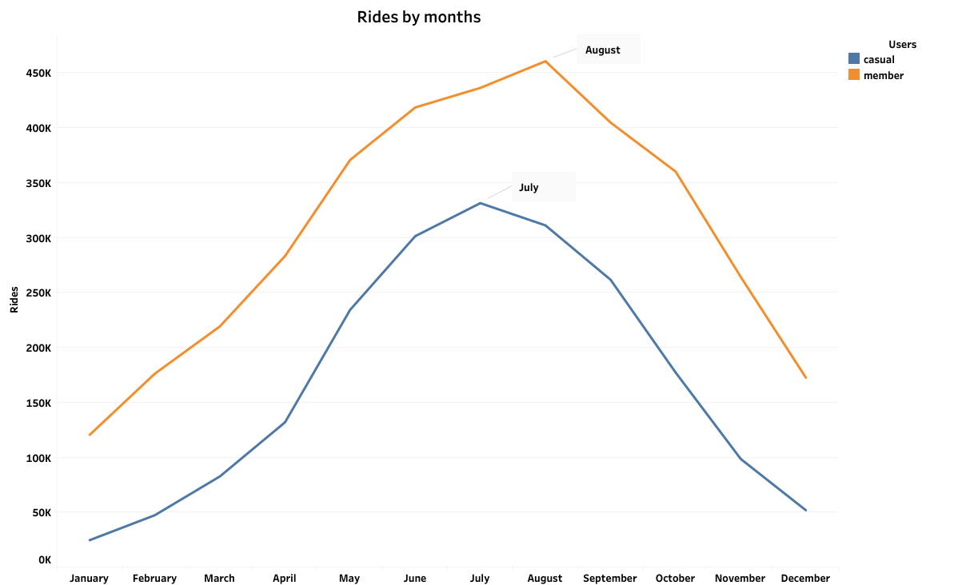
Monthly Ride Trends by User Type
Casual Riders: significant increase in rides during warmer months, peaking in July. Decline in usage during colder months, reflecting seasonal behavior
Member Riders: more consistent usage throughout the year, with a slight peak in August

Slide 7
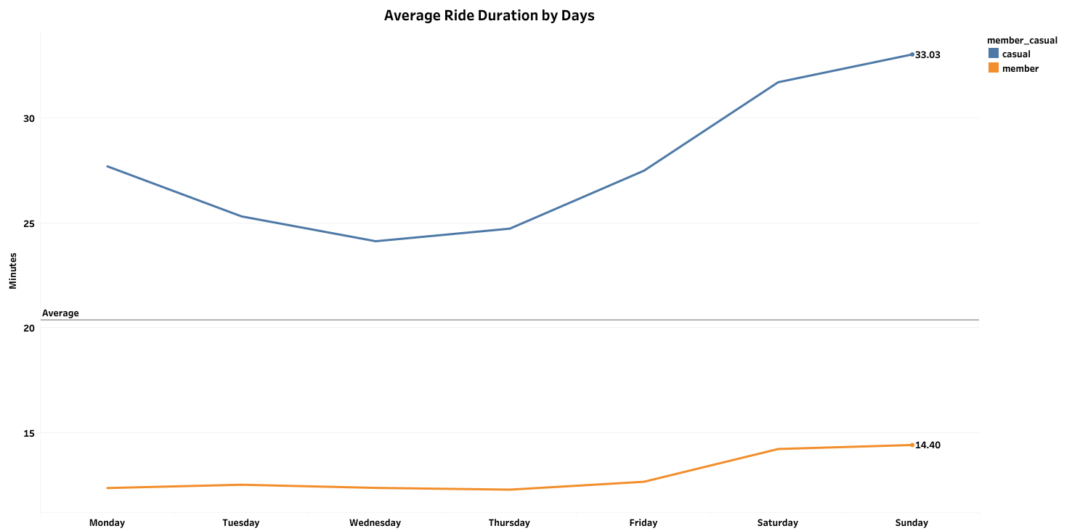
Average Ride Duration by Day of the Week
Casual riders have longer ride on weekends, reflecting leisure trips
Member riders maintain consistent ride durations throughout the week, indicating commuting habits

Slide 8
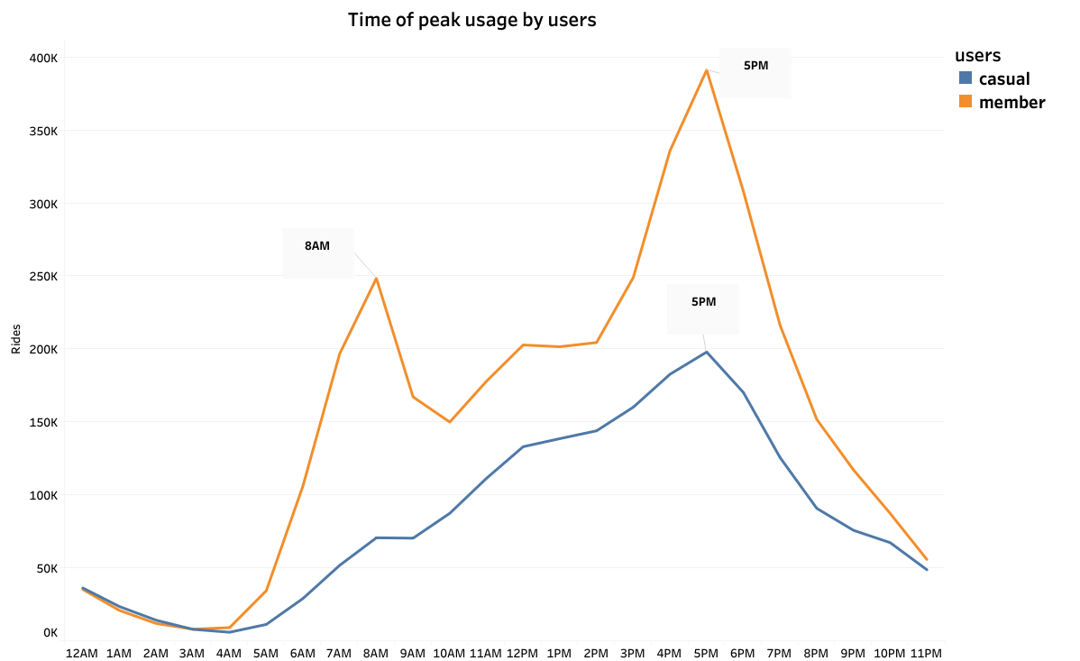
Time of Peak Usage by Users
Member riders peak at 8 AM and 5 PM, aligning with commuting hours
Casual riders show steady usage throughout the day, with no sharp peaks

Slide 9
Recommendations
Seasonal Campaigns: Launch targeted marketing campaigns in summer (July and August) to promote memberships. Highlight the cost benefits of annual memberships compared to single-ride payments
Weekend Promotions: Offer weekend membership trials or discounts to casual users, leveraging their longer ride durations on weekends
Weekend Accessibility: Ensure high availability of bikes near parks, tourist attractions, and leisure areas during weekends and summer months

Slide 10
Thank You!

